Slide 1

Blockable
Indian Identities on Smart Contracts

Slide 2
Identity is a Human Right
“When you already have a wheel, you can make a wheelbarrow...or a Tesla”
Lack of a shared, reliable ledger of identities is a major barrier for administering services in both the public and private sector. Millions of Indians cannot apply for loans or receive government support because their identifying information (Aadhar, PAN, TAN, etc) is not bundled together, linked to their date of birth, gender, address, etc, and retrievable from a single access point. This means SMEs that go out of business for lack of loans, farmers who can’t receive subsidies, and children who don’t have the right documents to attend school
2
Indian Identities on Smart Contracts

Slide 3
Blockchain for Digital Identity
KYC through an Ethereum smart contracts containing Aadhar, PAN, TAN, etc.
We have created one universal identity which contains all identifiable information like Names, Ancestries, Date of Birth, and Gender:
Stored immutably on the Ethereum blockchain
Accessible by multiple authorized parties
Able to be edited by certain authorities
Containing an audit trail of who changed what, who accessed what, and when they did it
3
Indian Identities on Smart Contracts

Slide 4


Front End
Blockable Prototype
Back End
Decentralized Identity
Citizen Creates Identity
Citizen inputs their information and associates it with their Ethereum wallet address and private key.

⧫
Contract Deployed between Authority and Citizen
Contract contains details of citizen including Aadhar, PAN, TAN, address, etc. Government validates these inputs by signing following transaction with their private key
4
Indian Identities on Smart Contracts

Slide 5



Front End
Back End
Citizen Requests Update
For change of address, mobile number, or other information, citizen can sign a change request with private key.
➔

Additional Transactions Created
Request, as well as government’s response and changes, are published as separate transactions onto the Ethereum blockchain
Government Approves Update
Government evaluates changes and, if appropriate, deploys new contract with changes to citizen’s identity and information
5
Indian Identities on Smart Contracts

Slide 6

Front End
Back End
3rd Part Request for Authentication
Access to identity contract for government agency, bank, or other business is granted when citizen signs their private key


Access Recorded as Transaction
When contract is accessed, ether is spent and the access is recorded as a transaction to enable e-paper trail for auditing purposes
Results:
Easier KYC for banks and businesses
Easier access for citizens to public and private services
6
Indian Identities on Smart Contracts

Slide 7

Read/Write
Read Only
Birth Certificate Issuer
Citizen Authentication
Banks and NBFCs
UIDAI/Aadhar
Government Agencies
Distributed Ledger
PAN Issuer
E-commerce Companies
7
Indian Identities on Smart Contracts

Slide 8
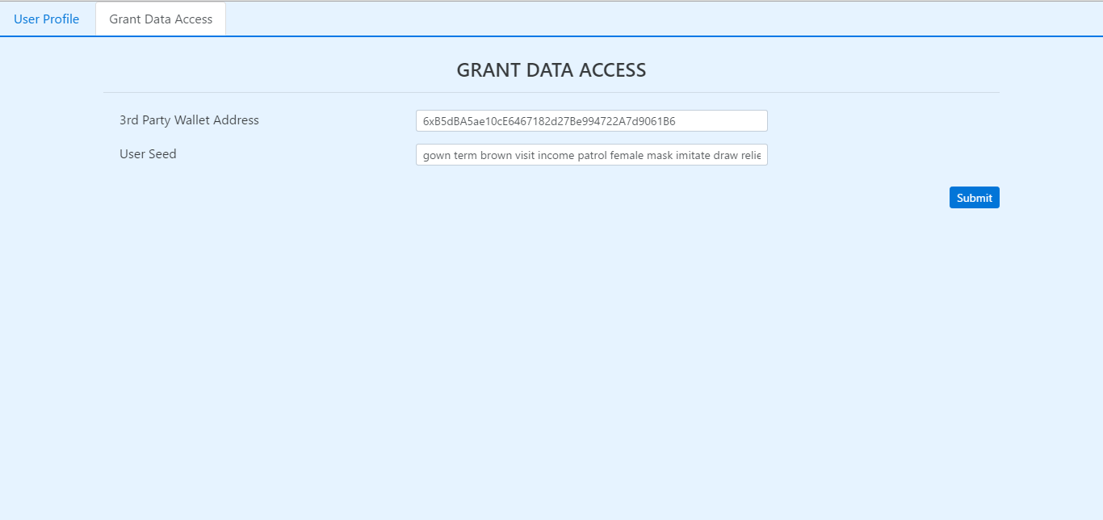
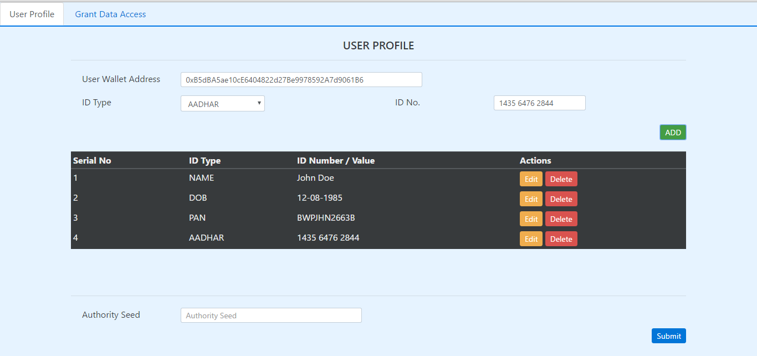
Prototype
Citizen UI
Government UI
8
Indian Identities on Smart Contracts

Slide 9
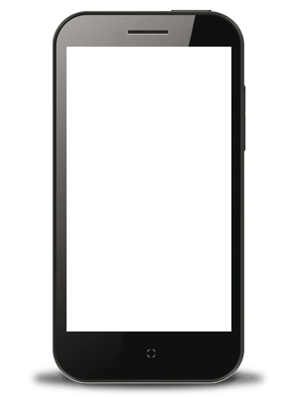
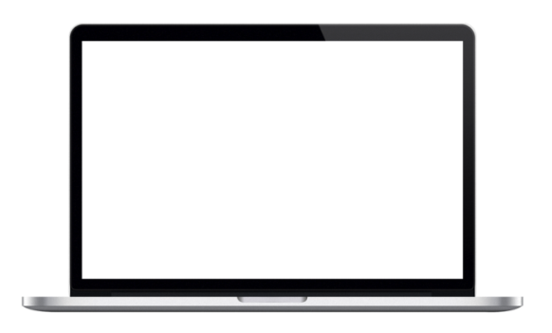

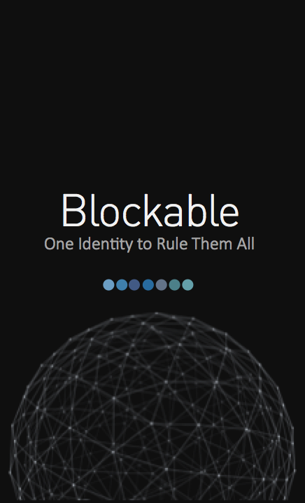
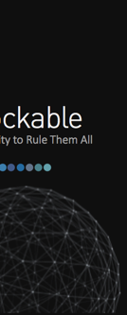
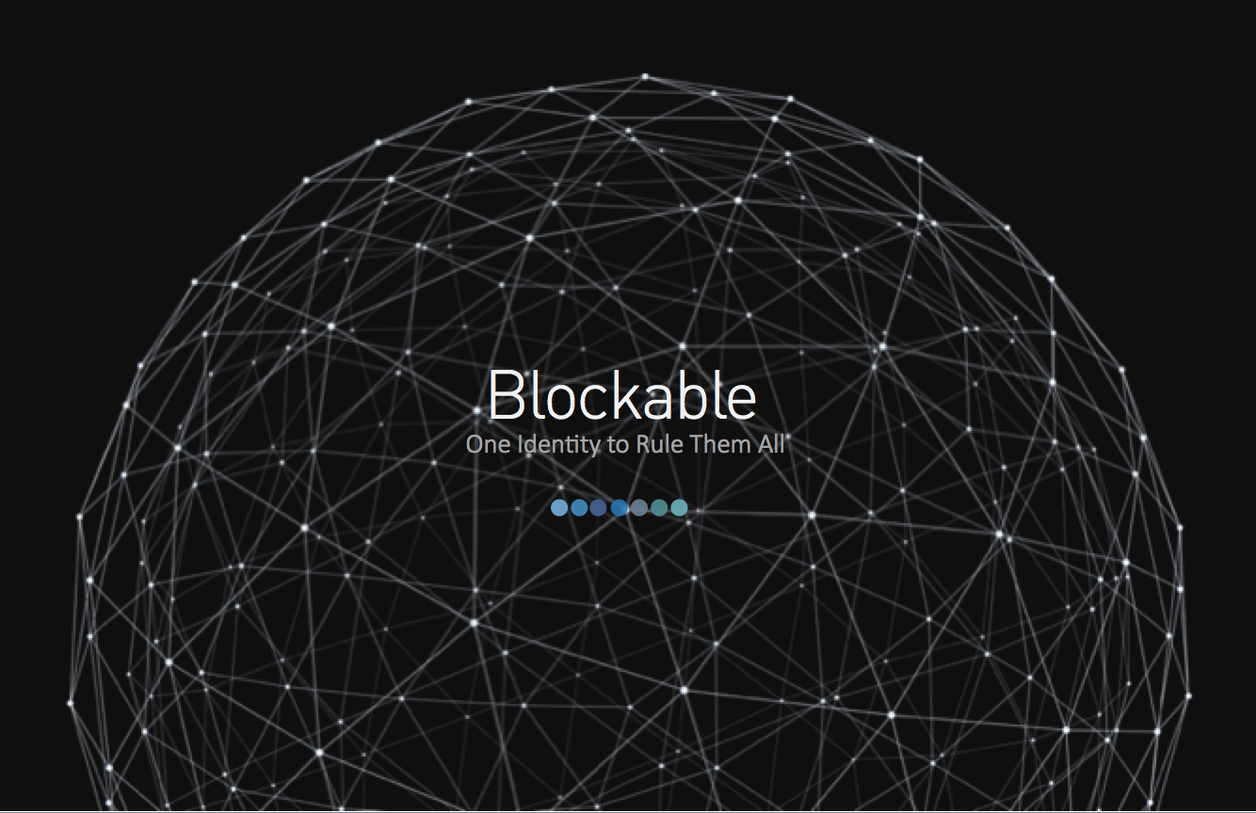
Blockable is a Human Right
Identity for a decentralized future
Take Your Identity Anywhere
Create an identity with just an internet connection and provide access just by signing your private key
Make Changes or Updates
Request to alter some aspect of your identity contract and the government will issue a new contract with updates
Fast Access for 3rd Parties
Customer authentication for banks, businesses, and government will be faster and more auditable
9
Indian Identities on Smart Contracts

